Slide 1
Selection of Optimal DNA Oligos for Gene Expression Arrays
Reporter : Wei-Ting Liu
Date : Nov. 7 2003

Slide 2
Abstract
Selection of optimal DNA oligos
- Based on sequence information and hybridization free energy
- Minimize background hybridization (true expression)
- Minimize the number of probes needed per gene (decrease the cost)

Slide 3
The Challenge of Probe Design
The quality of data from the oligo chip experiment relies on optimal probes
How to identify the optimun probes for each genes
1)Minimum hybridization free energy for that gene
2)Maximum hybridization free energy for all other genes in the hybridizing pool

Slide 4
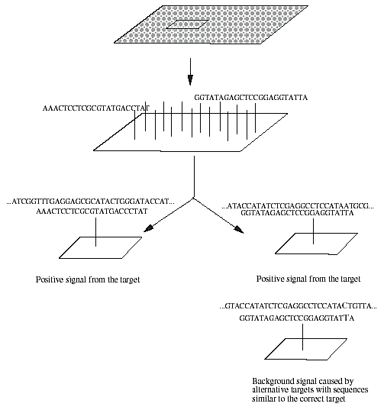

Slide 5
Optimum probe : problems
the energy is not computable from the sequence alone
1) Complete Structure of DNA
2) Concentration of genes
3) Complexity of algorithms
: how the time and memory requirements change when a genome size increases
Compute the theoretical energy from each gene to every possible hybridization partner.
( ignoring internal structure and concentration )
: computationally intractable

Slide 6
Approach
Two Major Steps
  Identify the set of candidate probes for each genes
  - Maximize the minimum number of mismatches to every other gene in the genome
  Compare candidate probes to determine their hybridization energy
  : mismatch types and positions affect stability of oligo DNA hybridization.
  : having free energy (ΔG) for the correct target in aceeptable range
  :

Slide 7
Algorithm
(1) make a suffix array of the coding sequences from a whole genome;
(2) build a sequence landscape for every gene based on the sequence suffix array;
(3) choose probe candidates based on sequence features and the sequence word rank values;
(4) search for matching sequences in the whole genome;
(5) locate match sequence positions in all genes;

Slide 8
Algorithm
(6) calculate the free energy G and melting temperature (Tm) for each valid target
(7) select match sequences that have stable hybridization structures with other targets in the genome

Slide 9
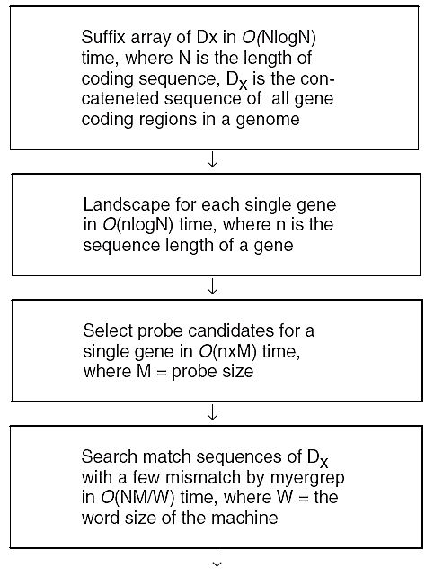
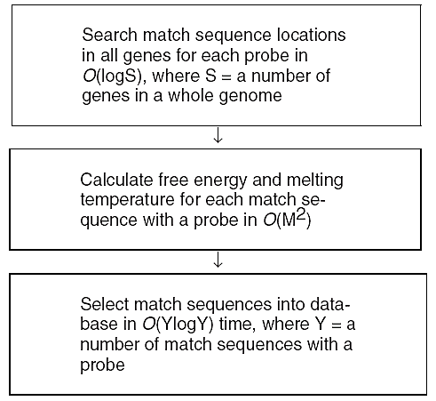

Slide 10
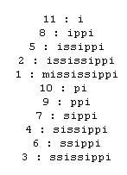
1. Sequence Suffix Array
Suffix Array
Data structure for efficiently searching whether S is a substring of string T.
For a given string T, we construct the lexicographically sorted array of all its suffixes. ( For T = mississippi, the suffix array
is )
Suffix array is a sorted list of all the
suffixes of a sequence
Build a sequence suffix array of both
strands for all coding sequences of a genome,
which are concatenated

Slide 11
In a suffix array, all suffixes of S are in the non-decreasing lexical order.
For example, S=“ATCACATCATCA”
”
i | 1 | 2 | 3 | 4 | 5 | 6 | 7 | 8 | 9 | 10 | 11 | 12
A | 12 | 4 | 9 | 1 | 6 | 11 | 3 | 8 | 5 | 10 | 2 | 7
4 | ATCACATCATCA | S₍₁₎
11 | TCACATCATCA | S₍₂₎
7 | CACATCATCA | S₍₃₎
2 | ACATCATCA | S₍₄₎
9 | CATCATCA | S₍₅₎
5 | ATCATCA | S₍₆₎
12 | TCATCA | S₍₇₎
8 | CATCA | S₍₈₎
3 | ATCA | S₍₉₎
10 | TCA | S₍₁₀₎
6 | CA | S₍₁₁₎
1 | A | S₍₁₂₎
1 | A | S₍₁₂₎
2 | ACATCATCA | S₍₄₎
3 | ATCA | S₍₉₎
4 | ATCACATCATCA | S₍₁₎
5 | ATCATCA | S₍₆₎
6 | CA | S₍₁₁₎
7 | CACATCATCA | S₍₃₎
8 | CATCA | S₍₈₎
9 | CATCATCA | S₍₅₎
10 | TCA | S₍₁₀₎
11 | TCACATCATCA | S₍₂₎
12 | TCATCA | S₍₇₎

Slide 12

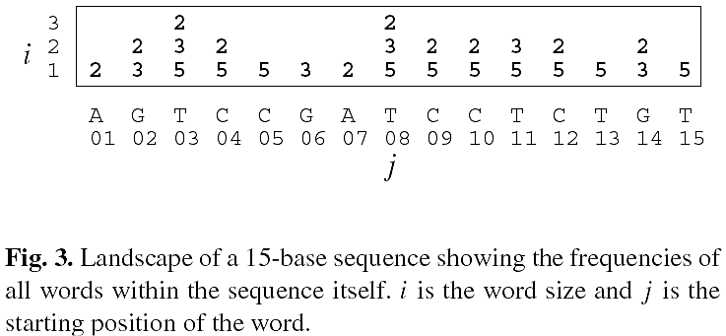
2. Sequence Landscape (1)
A landscape represents the frequency in the database of all the words in the query sequence
15 base query sequence, same sequence as a database
Every cell in the landscape, , indicates the frequency of a word (position j, length i) in the database

Slide 13
3. Selection of Short or Long Probe Candidates
All potential probes are evaluated by the frequency of matching subwords in the database of other sequences
Can use additional constraints
  No single base (As, Ts, Cs, or Gs) exceeds 50% of the probe size
  The length of any contiguous As and Ts or Cs and Gs region is less than 25% of the probe size
  (G+C)% is between 40 and 60% of the probe sequence
  No 15-long contiguous repeats anywhere in the entire coding sequence of the whole genome
  No self-complementarity within the probe sequence

Slide 14
Candidates selection (1)
Probe size from 20 bases to 70 bases
A sequence landscape for each gene is used to select probes with low frequency in the rest of the genome
  Approximate match→
    Use the landscape information to get an estimated rank of the number of approximate matches for each potential probe of each gene
    Top Q (from 10 to 20) probe candidates are selected

Slide 15
Candidates selection (2)
Based on tests of many E.coli genes, found that summing the frequencies of words at each of several different word lengths (i.e. heights in the landscape) gives a good predictor of the number of matches in the background sequence
→ candidates probes are chosen by finding the probe-sized words within a gene sequence that minimize the sum of its sub-word frequencies

Slide 16
Candidates selection (3)
Example
  The words sequence : ATGCCA
  ATG: beginning sub-word
  f (ATG): the frequency of the word which occurs in coding sequence and its complement in the whole genome
  Overlapping frequency of word s
    F(s) = f(ATG) + f(TGC) + f(GCC) + f(CCA)

Slide 17
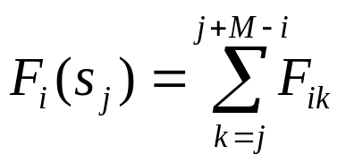
Candidates selection (4)
  i is column height of the gene landscape
  j is the word position
  M is the probe size and j < n-M
  n is the sequence length of the gene
For each word size i, the 10 positions with the lowest overlap frequency are saved
All positions are ranked by the number of times they occur on those lists
The highest ranking probes are predicted to have the fewest approximate matches elsewhere in

Slide 18
4. Mismatch Searching for Candidate Probes
The approximate string search is to find all locations at which a query of length m matches a substring of a text of length n with k-or-fewer differences
Candidate probes in the coding regions of the genome with four or fewer mismatches (insertion, deletion, mismatch)

Slide 19
5. Localization of the Match Sequences in Each Gene
Fast approximate string searching
The matches can be assigned to their exact positions within the specific genes
All gene positions can be built into the sorted array
All match positions to the probe can be located in the specific gene by a binary search of the sorted array
If the match sequences are across two genes, they are not valid

Slide 20
(6) Free Energy and Melting Temperature Calculation
Consider DNA hybridization structure
Using thermodynamic parameters could predict stability of DNA oligo hybridization approximately
“SantaLucia,J.J. (1998) A unified view of polymer, dumbbel, and oligonucleotide DNA nearest-neighbor thermodynamics. Natl Acad. Sci. USA, 95, 1460–1465.”

Slide 21
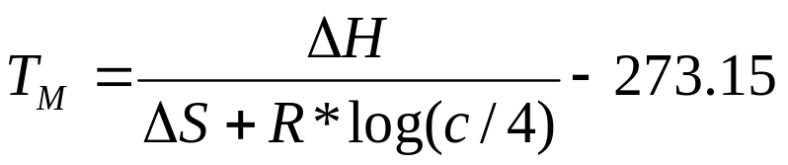




Melting Temperature Calculation
Tm can be used as a parameter to evaluate probe hybridization behavior
Tm is calculated for each probe as
  Enthalpy(Kcal/mol), : entropy(Kcal/mol)
  R: molar gas constant
  c: total molar concentration of the annealing oligonucleotides

Slide 22
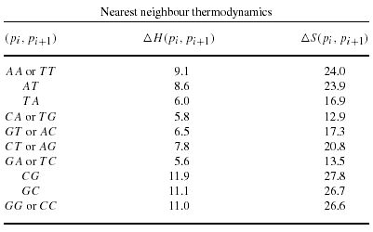
Melting temperature
Melting temperature are specified by nearest neighbor thermodynamic
ex:p=GCAT with
△(GGAT)=
△H(GG)+△H(GA)+△H(AT)
= 11.0 + 5.6 + 8.6
= 25.2(kcal/mol)

Slide 23
Probe Selection
Uniqueness
  Comparing potential probe sequences with the full-length sequences of other genes being monitored
Hybridization characteristics
  Tm among probes
  GC content
  Secondary structure
  Number of mismatch

Slide 24
Thank you

